Slide 1
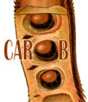

Achievements 2023: Data ecosystem
Data collection monitoring dashboard
Standarized survey design, data collection
ONA
data
mgmt
MyEiA
ODK Collect
DATA POOL
Impact Dashboard
AgWise, analytics, DSSAT+
Notes:
From the Transform presentation at the Learning Event in Vietnam by Medha

Slide 2
Validation exercises – ODK (data collection) forms in the EiA data ecosystem
ODK forms in the validation exercises
VAL_data: collects the data in the field during the validation exercise
VAL_DST: generates the test treatment in the field for validations of dynamic, site-specific solutions
VAL_monitor: collects data that evaluate the validation exercise at each farm site. Used for example by the supervising research team. Besides detailed evaluation data it provides a “yes – no” assessment for quick processing.
=> up to now, we have given most attention to VAL_data

Slide 3
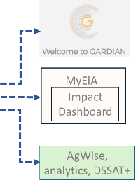
Validation exercises – ODK (data collection) forms in the EiA data ecosystem
Generate VAL_data
Data collection monitoring dashboard
Provides overview of incoming data
Removes duplicated submissions
ODK Collect
ONA
UC Laptop
Data cleaning (VAL_monitor; data evaluation)
Linking with VAL_DST
Copy of raw data
DATA POOL
Copy of clean data
Copy of clean data

